Slide 1
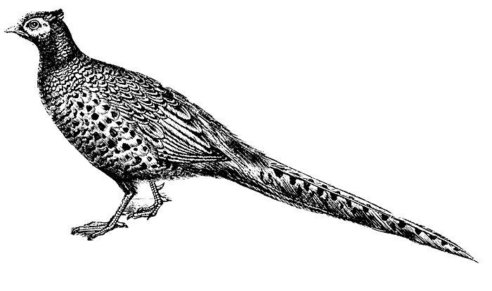
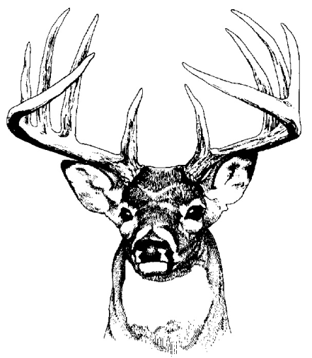
WILD LIFE CDE
(An Introduction to Contest Organization)

Slide 2
Purpose:
This contest creates a fun and competitive environment to learn management & conservation of natural resources for wildlife habitat, knowledge of and respect for laws related to hunting and other outdoor recreational activities, and safety.

Slide 3
Application:
Austin Career Readiness:
NRCS
TEXAS PARKS AND WILDLIFE
AGRILIFE extension
SWCA environmental services
Horizon environmental services
Ranger environmental services
Travis County Park Rangers
Local hunting & fishing guides
Lower Colorado River Authority

Slide 4
Team Format:
This is a 4 person team; the top three scores count.
The dress is field appropriate.
Team members must bring:
Scan Sheet
Transparent Clipboards
Basic Calculator
Plastic Bag for Storing Sheet in Rain
Manilla Folder
#2 Pencils

Slide 5
TEST OVERVIEW:
PLANT ID – 30 pts
WILDLIFE PLANT PREFERENCE – 45 pts
WILDLIFE BIOLOGICAL FACTS – 20 pts
WILDLIFE HABITAT EVALUATION – 9 pts
WILDLIFE AND HABITAT MANAGEMENT PRATICES - VARIES
GAME LAWS - 15 pts
SAFETY - 15 pts
TECHNIQUES - 20 pts

Slide 6
Test Questions! Sec I
PLANT ID
For this section there will be 15 plants present, dried, live, or cut that you will identify and mark on your scantron.
We study these native plants in Advanced Plant & Soil Science Anyway!

Slide 7
Test Questions! Sec II
WILDLIFE PLANT PREFERENCE
For this section of the test you are given three wildlife species and a list of 15 plants. You must mark which plants the species prefers.

Slide 8
Test Questions! Sec III
WILDLIFE BIOLOGICAL FACTS
For this section you have 20 questions about different wildlife species to answer.
The wildlife will come from our region.

Slide 9
Test Questions! Sec IV
WILDLIFE HABITAT EVALUATION
For this section, you will evaluate a site and its ability to meet three livestock species needs.
You will get information about the site, as well as maps and a list of three species. You must indicate whether the site is adequate or deficient for food, cover, and water.

Slide 10
Test Questions! Sec V
WILDLIFE HABITAT MANAGEMENT
For this section the student will be given a list of management actions that could be applied to the property with a list of three species. The student should mark the actions that should be done to the property for each species.

Slide 11
Test Questions! Sec VI
GAME LAWS
This is a 15 question T/F or multiple choice game law question section.

Slide 12
Test Questions! Sec VII
SAFETY
This section is 5 to 15 points and the answers can be safe/unsafe or multiple choice.

Slide 13
Test Questions! Sec VIII
TECHNIQUES:
This section uses knowledge of a skill, like aging a deer by a jawbone. There will be 20 questions.

Slide 14
End Notes:
Everything is in the Study Guide!!!
A lot of the contest is covered in class!!!

