Slide 1
Temple Grandin Animals in Translation
Advanced Animal Science Book Study
Ms. Julia Ricicar
Lanier High School – Austin Texas
“They'll be very calm. Nature is cruel but we don't have to be; we owe them some respect. I touched the first cow that was being stunned. In a few seconds it was going to be just another piece of beef, but in that moment it was still an individual. It was calm... and then it was gone. I became aware of how precious life was.” – Temple Grandin

Slide 2
How This Came About
School Administration requested all CTE courses read a books with technical information in them.
Why - Increase college reading readiness and improve test scores.
This next year we were asked to incorporate more writing and I will be using this book to stimulate topics.

Slide 3
Title | Author | Class Used In
Animals in Translation | Temple Grandin | Advanced Animal Science
Tell Me Where it Hurts | Dr. Nick Trout | Vet Medicine
The Joys of Keeping Farm Animals | Laura Childs | Livestock Prod/Small Animal
Dirt – The Ecstatic Skin of the Earth | William Bryant Logan | Advanced Plant and Soil Science
Shop Class As Soulcraft | Matthew B. Crawford | Ag Mechanics
The Omnivore's Dilemma | Michael Pollan | Principles of Ag

Slide 4
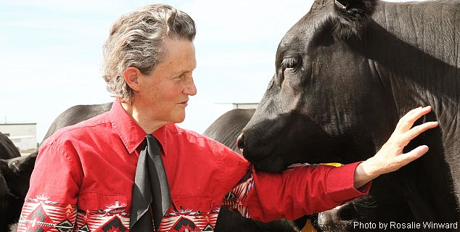
Introduction to Temple Grandin
http://www.youtube.com/watch?v=cpkN0JdXRpM
Temple Grandin is world-famous for using insights gained from her autism to lead dramatic improvements in the livestock industry. She has been a professor at Colorado State for more than 20 years and she has helped design over half of all cattle processing facilities in North America.

Slide 5
How Animals in Translation Fits Into My Class
The students come into class and get their book and notebook.
I post the page numbers they need to read and questions they need to answer on the board.
The students know that we will go over the questions after 15-20 minutes, but they must be silent, reading, and trying to answer questions.
The students really enjoy the book and like to read it and will take it home and catch up on the reading if they were absent.

Slide 6
Tips to Incorporating Animals in Translation in Your Class
Do not read more than 3-4 pages a day.
Make sure you grade their questions.
Go over the questions and allow them to discuss, but make sure you keep the students focused.
You can read the book page by page or skip around based on the topic being covered.
I have a general outline of what is in each chapter, but it is a work in progress.

Slide 7
Chapter/Section | Topics Discussed | Activities
Chapter 1 – My Story | Her History, Basic Animal Needs and Behavior | Watch the HBO Temple Grandin Movie
Chapter 2 – How Animals Perceive the World | What Animal See and Hear, Tiny Details That Scare Farm Animals | Why Hogs and Cattle Refuse to Walk Through an Ally or Chute (Guess and Discuss Game)
Chapter 3 – Animal Feelings | Single Trait Breeding, 4 Core Primal Emotions, 4 Primary Social Emotions, Animal Breeding Emotions | Discussion for Single Trait Breeding as it relates to Breeding Pig, and Primal and Social Emotion Observations
Chapter 4 – Animal Aggression | Different Animal Aggressions and What Causes Aggression | Using Life Experiences and Movie Clips We Determine the type of Aggression an Animal is Expressing
Chapter 5 – Pain and Suffering | Do Animals Feel Pain and if So How and Why? | Discussion on How Animal and Human Brains Work
Chapter 6 – How Animals Think | Observable, Behavioral, and Scientific Information on What Animals Think | Discuss Animal Welfare Practices and Management
Chapter 7 – Animal Genius Extreme Talents | Animals Talents | Watch Movie Clips and Find News Stories of Animals Doing Amazing Things

Slide 8
Answering the Questions
The students cut and glue all their work into interactive notebooks.
At the beginning of the year the students set up their notebooks with the questions on one side of the page and they answer the questions of the other side.
As they read they answer the questions in the book.
There are tons of ideas on how to set them up on Pinterest.

Slide 9
Examples and Contact Information
I will place a copy of all the books as well as the interactive note book in the back of the room so after the workshop you can view them.
If you want a copy of this presentation and the questions that were written to go along with the book it will post it on Lanier FFA Webpage
http://www.lanier.ffanow.org/
It will be in the Instructor/Advisor section under Ms. Ricicar
If you have any questions please contact me at:
Julia.ricicar@austinisd.org

